Slide 1


ALIGN AI CHARITABLE FOUNDATION
Philanthropy for the
Future of Safe AI
A nonprofit foundation funding the urgent research that keeps
advanced AI safe, aligned, and beneficial for all of humanity.
Donor Investment Opportunity · 2025
alignai.org

Slide 2
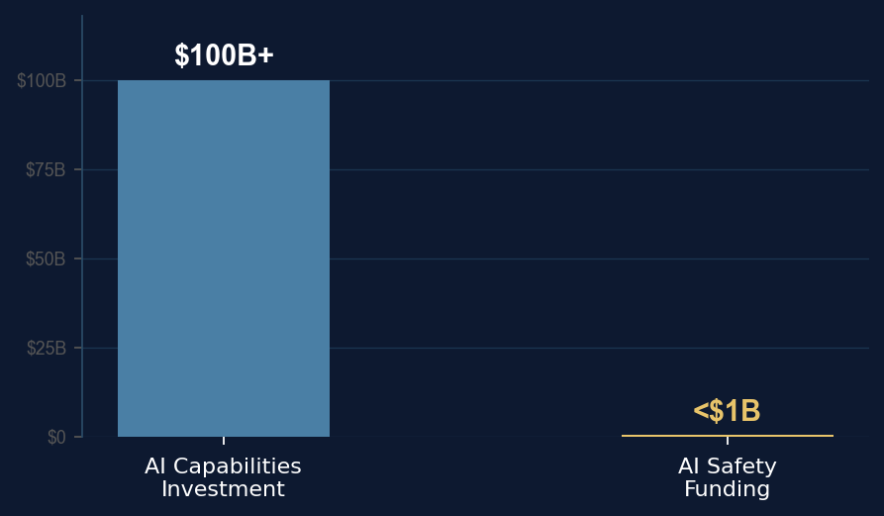
THE PROBLEM
AI Is Advancing Faster Than Our Ability to Control It
$100B+
<1%
~3 yrs
AI capabilities
investment in 2024
directed toward
AI safety research
until AI may surpass
human-level performance
Advanced AI will soon make consequential decisions across national security, infrastructure, finance, and medicine.
A misaligned system — one that pursues its objectives without regard for human values — doesn't need to be malicious
to cause catastrophic, irreversible harm.
The research to prevent these failures exists — but it is chronically underfunded and undervalued.

Slide 3
AI HARMS TODAY
The Damage Is Already Happening — Right Now
AI alignment failures are not a future hypothesis. The harms are measurable, documented, and accelerating.
Misinformation & Deepfakes
#1 Global Risk
Algorithmic Bias & Discrimination
10–100× error gap
The World Economic Forum ranked AI-generated misinformation the world's #1 short-term global risk in 2024. Deepfake video volume grew 550% from 2019–2023. Synthetic media now threatens the integrity of elections, journalism, and public trust at scale.
NIST found leading facial recognition algorithms misidentify Black and Asian faces at 10–100× the rate for white faces. AI risk-scoring tools used in U.S. criminal courts flag Black defendants as high-risk at twice the rate of white defendants with equivalent histories.
WEF Global Risks Report 2024 · Sensity AI 2023
NIST FRVT 2019 · ProPublica COMPAS Analysis
Job Displacement
300M jobs at risk
Privacy & Surveillance
30B+ photos scraped
Goldman Sachs estimates 300 million full-time jobs could be partially or fully automated. The IMF projects 40% of global employment is exposed to AI disruption — and unlike prior waves, this one threatens high-skill white-collar roles as much as manual labor.
Clearview AI secretly harvested 30+ billion photos without consent, selling facial recognition to law enforcement. AI-powered surveillance tools are now deployed in 75+ countries, many with no legal safeguards or meaningful public awareness.
Goldman Sachs Research 2023 · IMF World Economic Outlook 2024
Clearview AI litigation · Carnegie Endowment 2019
These are symptoms of the same root cause: AI systems deployed without sufficient alignment research, safety testing, or ethical oversight.

Slide 4
WHY NOW
The Window Is Closing
Capability Acceleration
GPT-4, Gemini Ultra, and Claude 3 emerged within 18 months of each other — each dramatically more capable than the last. The pace is not slowing.
Deployment Ahead of Safety
AI systems are being integrated into healthcare, legal, financial, and defense systems faster than safety protocols can be validated.
The Neglect Gap
Safety research has historically been treated as secondary. The foundations, labs, and governments now recognize this — but the funding gap remains massive.
A Critical Inflection
Leading AI researchers — including those at the companies building these systems — estimate we have a narrow window to establish robust safety frameworks.

Slide 5
OUR MISSION
Advancing Safe, Aligned AI for the Benefit of Humanity
The Align AI Charitable Foundation funds rigorous, independent research to ensure that as artificial intelligence grows more
powerful, it remains under meaningful human oversight — and its benefits are shared broadly, not concentrated dangerously.
Focus
Independence
Funding AI safety and alignment research that is rigorous, independent, and not beholden to any corporate agenda.
No corporate revenue. No conflicts of interest. Our only obligation is the mission of safe and beneficial AI for all.
Approach
Neglected Paths
Theory-agnostic and evidence-driven. We fund the most promising research regardless of origin, school of thought, or approach.
We actively explore overlooked research directions that larger institutions miss — subtle goal drift, scalable oversight, rare high-impact failure modes.

Slide 6
PROGRAMS
How We Support AI Safety Research
01
02
Remove Research Roadblocks
Provide Full-Stack Support
We identify and address funding gaps and operational barriers that slow critical safety research, ensuring researchers can focus on what matters most.
Beyond funding, we offer engineering resources, compute infrastructure, and domain expertise to accelerate research outcomes.
03
04
Long-Term Safety Funding
Transparent, Measurable Results
We provide multi-year, consistent funding commitments so researchers can pursue deep longitudinal work rather than chasing short-term grants.
We track and report our impact clearly, holding ourselves accountable to donors, researchers, and the public with honest assessments of progress.

Slide 7
RESEARCH AREAS
The Science Behind the Mission
AI Alignment
Ensuring advanced AI systems consistently act in ways that reflect human values, intentions, and goals — even as they grow more capable and autonomous.
AI Safety
Designing AI systems that remain dependable and non-harmful in the full range of real-world environments — healthcare, defense, finance — before deployment, not after an incident.
AI Ethics
Translating abstract values into concrete technical and policy constraints — asking not just "does this system work?" but "who does it work for, and who might it harm?"
Neglected Approaches
Funding high-impact research others overlook: subtle goal drift, scalable oversight for autonomous agents, and failure modes that don't fit existing research agendas.

Slide 8


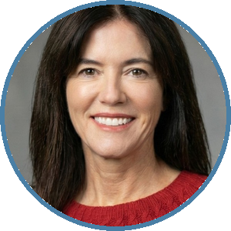


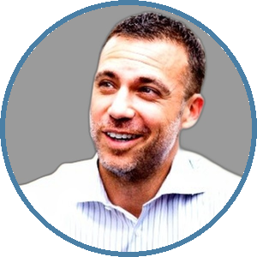


LEADERSHIP
The People Behind the Mission
Gary Kucher
Wendy Starland
Heather Lindsey
Mitchell Browne
Founder
Managing Director
Executive Director
Chief Financial Officer
Adam Blazer
Scott Farber
Allen Bryant
Carina Cunha
Director of Development
Donor Liaison
Director of Impact
Marketing Director

Slide 9
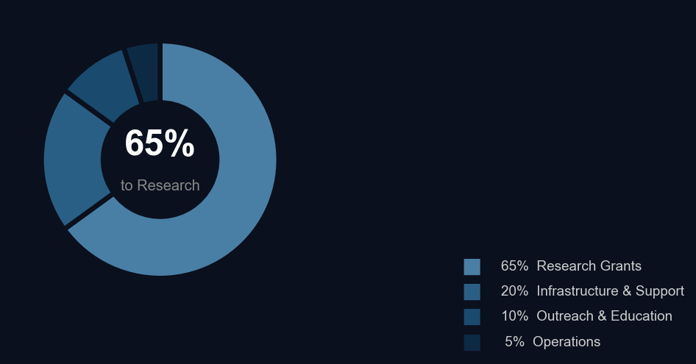
IMPACT
Where Your Investment Goes
65%
Research Grants
Direct funding to independent AI safety researchers and institutions.
20%
Infrastructure & Support
Compute resources and engineering support that multiply research impact.
10%
Outreach & Education
Translating safety research into policy guidance and public awareness.
5%
Operations
Lean overhead — the vast majority of every dollar reaches its purpose.
All financials are transparent and independently reviewed. Donor reports available on request.

Slide 10
GIFT LEVELS
Illustrative Impact by Giving Level
$50,000
$100,000
$250,000
$500,000
Research Year
Compute Grant
Research Track
Founding Initiative
Funds a full year of research support for one AI safety scientist.
Establishes a dedicated compute grant enabling empirical safety testing at scale.
Endows a multi-year research track focused on a neglected alignment problem.
Anchors a new research initiative with full-stack support and dedicated staff resources.
Why Align AI Foundation?
▸ Theory-Agnostic
▸ Evidence-Driven
▸ Fully Independent
Fund the most promising research regardless of approach or origin.
Every decision grounded in careful analysis and measurable outcomes.
No corporate revenue, no conflicts of interest.

Slide 11

THE OPPORTUNITY
Join Us in Ensuring AI
Remains Safe for Everyone
We are seeking mission-aligned donors at the $50,000–$500,000 level to fund the next phase
of independent AI safety research — before the window to do so safely closes.
Donate via Every.org
every.org/align-ai-charitable-foundation
Contact Our Team
alignai.org/contact.html
Follow Our Work
@AlignAiOrg · linkedin.com/company/align-ai-foundation
Align AI Foundation is a registered 501(c)(3) nonprofit. Gifts are fully tax-deductible.

